Slide 1
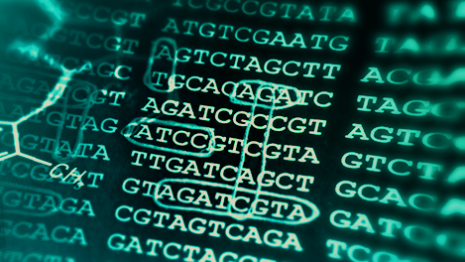

Introduction to Bioinformatics Final Project
Exploring biological crosstalk between COVID-19 and HIv
FACULTY OF COMPUTER SCIENCE – TECHNION 23/03/23
Ofer Nissim 312367576
Tom Smolin 313552739

Slide 2
Background
COVID-19 is caused by SARS-CoV-2 and is responsible for one of the worst pandemics in modern history.
Human immunodeficiency virus (HIV) destroys immune system cells and weakens the body's ability to resist infections and diseases. The World Health Organization estimates that as of 2021, HIV/AIDS has killed about 36.3 million people and affected approximately 37.7 million people worldwide.
The existing research is lacking in understanding the molecular mechanism underlying the crosstalk between COVID-19 and HIV.
The aim of our work is to illustrate blood transcriptome crosstalk between COVID-19 and HIV and provide a basis for diagnosis and potential treatments for HIV-infected COVID-19 patients.

Slide 3

Literature review
Previous studies showed that HIV-infected individuals had double COVID-19 mortality risk and experienced worse COVID-related outcomes.
- Tesoriero JM, Swain CE, Pierce JL, Zamboni L, Wu M, Holtgrave DR, et al. et al: COVID-19 outcomes among persons living with or without diagnosed HIV infection in new York state. JAMA Netw Open (2021) 4(2):e2037069.doi: 10.1001/jamanetworkopen.2020.37069
- Davies MA. HIV And risk of COVID-19 death: a population cohort study from the Western cape province, south Africa. medRxiv (2020). doi: 10.1101/2020.07.02.20145185
- Dong Y, Li Z, Ding S, Liu S, Tang Z, Jia L, et al. HIV Infection and risk of COVID-19 mortality: A meta-analysis. Med (Baltimore) (2021) 100(26):e26573. doi: 10.1097/MD.0000000000026573
According to a recent study, HIV was also an independent risk factor for both severe/critical COVID-19 at admission and in-hospital mortality.
- Bertagnolio S, Silva R, Nagarajan S, Thwin S, Jassat W, Fowler R, et al. Are people living with HIV at higher risk of severe and fatal COVID-19? In: Journal of the international aids society, vol. 2022. (West Sussex, England:John Wiley & Sons Ltd_ (2022). p. 17–8. The Atrium, Southern Gate, Chichester Po19 8sq, W.
Therefore, it is essential to explore potential molecular mechanisms and screen out potential small molecular compounds for the treatment of HIV-infected COVID-19 patients.

Slide 4

Research question
Are the common DEGs of both COVID-19 and HIV related to a pathway, which may lead to a worse prognosis amongst HIV patients with COVID-19?
If so – which pathway?

Slide 5
Motivation
In our clinical exposure course to medicine, we visited the HIV clinic at RAMBAM hospital and had a discussion with HIV patients.
During this discussion, we realized the complexities (of both social and physical aspects) these patients bear.
Then we thought it’ll be interesting to research an issue related to the disease.
When COVID-19 emerged in our lives, it caused panic and uncertainty among us all. But knowing that handling the HIV condition is a struggle by itself, we wanted to examine if there is some sincere place for further concern for HIV patients.
We knew from past research that the COVID-19 prognosis might be worse for HIV patients and that these patients are at enhanced risk.
We wanted to understand the reasons that might lead to that cause, as we felt that we can find the right data to produce some comprehensible conclusions.

Slide 6

Hypothesis
Our hypothesis is that the common DEGs of both conditions are indeed related to a pathway, that may affect the progress of the disease and its outcome.
We may identify pathways that are related to the prognosis as we thought, but it’s also possible that the analysis won’t produce any relevant pathways (disease-wise).
Another possibility is to have an outcome that may imply some conclusions but on the other hand, will lack reliability in the numerical and statistical sense (e.g., due to an insufficient amount of data).

Slide 7
design
GSE37250
Bulk-RNA-seq
GSE171110 GSE152418
Bulk-RNA-seq
We also used for clarification – PCA, heatmaps, VEN diagrams, volcano plots, boxplots
HIV Gene Expression analysis
(Limma)
COVID-19 Gene Expression analysis
(DESeq2)
Common DEGs
TCGA (on severity and ICU)
And xCell
GSEA

Slide 8
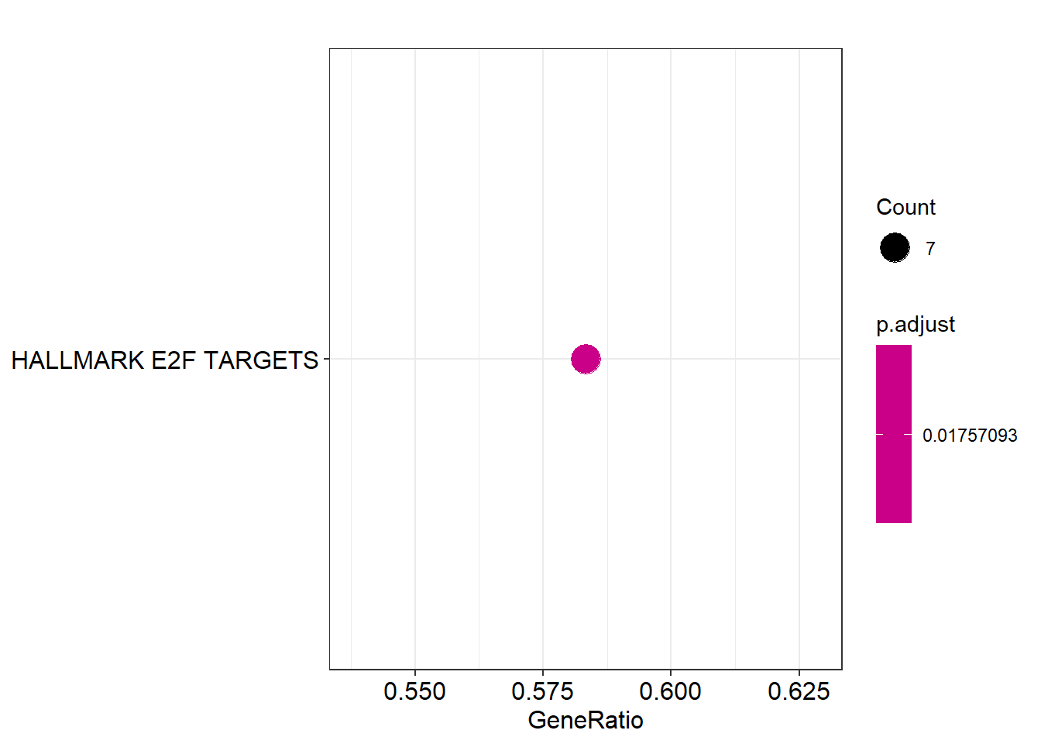
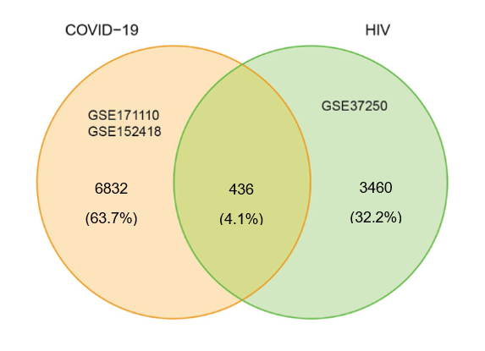
Results – First analysis
We started with 3 datasets (2 COVID-19, and 1 HIV).
Tried to imitate the results of an experiment: https://www.frontiersin.org/articles/10.3389/fimmu.2022.1008653/full#B19
Had to pre-process the data and figure out how to use new tools for analysis (sidenote – didn’t use all the tools from the exp. Excluded: NNs, Protein drug interaction, KEGG, etc.).
In the end, got a result that may be not completely reliable, but on the other hand – fits the article’s results (cell-cycle pathway).
Important note: There is a small number of common DEGs, Hence, in some manner it’s reasonable to expect just a few pathways.

Slide 9

Results – First analysis
“ In a cell cycle, a specific sequence of events takes place such as cell division, DNA replication, nuclear membrane rupture, spindle formation, and preparation for chromosome segregation (61). Many studies have shown that viral replication and survival are facilitated by viruses regulating host cell cycle processes”
Blood transcriptome analysis revealed the crosstalk between COVID-19 and HIV, Cheng Yan*†, Yandie Niu† and Xuannian Wang*†
https://www.frontiersin.org/articles/10.3389/fimmu.2022.1008653/full

Slide 10
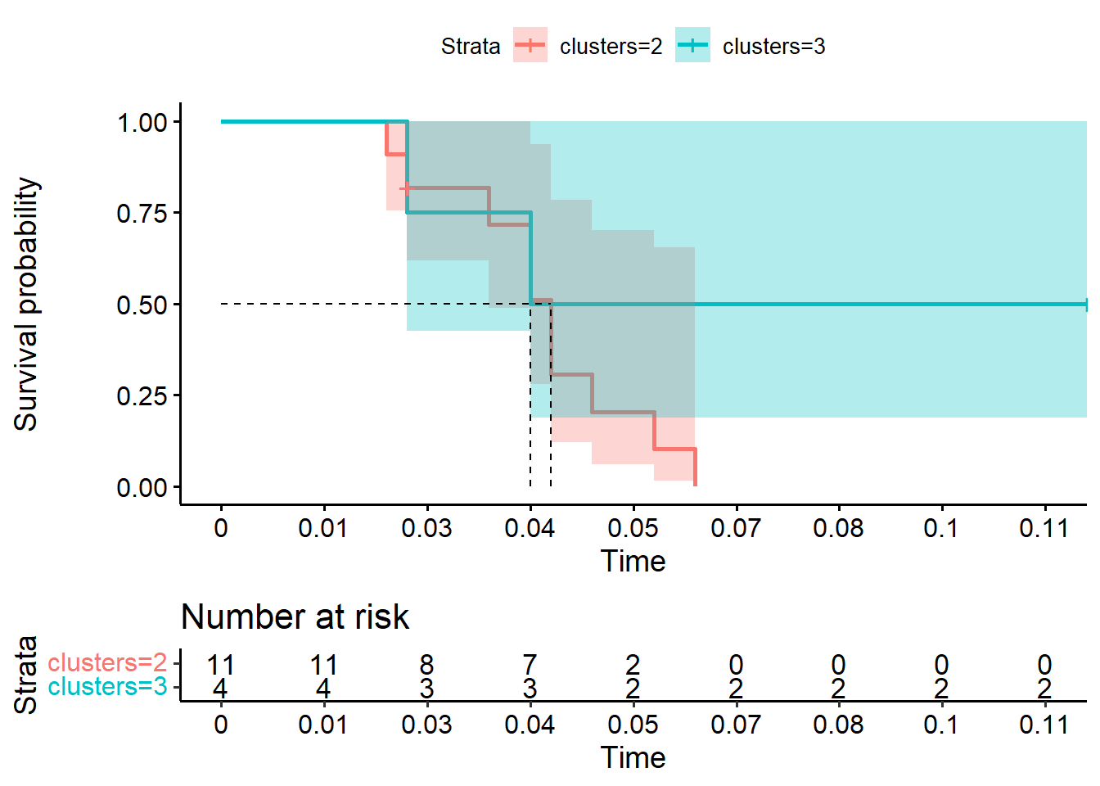
Results – second analysis
We performed survival analysis with xCell.
We intended to better understand the survival rates of the patients, grouped according to similar gene expression levels.
Because our data didn’t contain mortality information, we used severity status instead, to label “death” condition.
The results implied that patients with higher expression levels (linked to both diseases) may tend to worse prognoses.
Notes:
Xcell allows to distinct between the groups by composition and properties of cell types, using the DEGs.

Slide 11
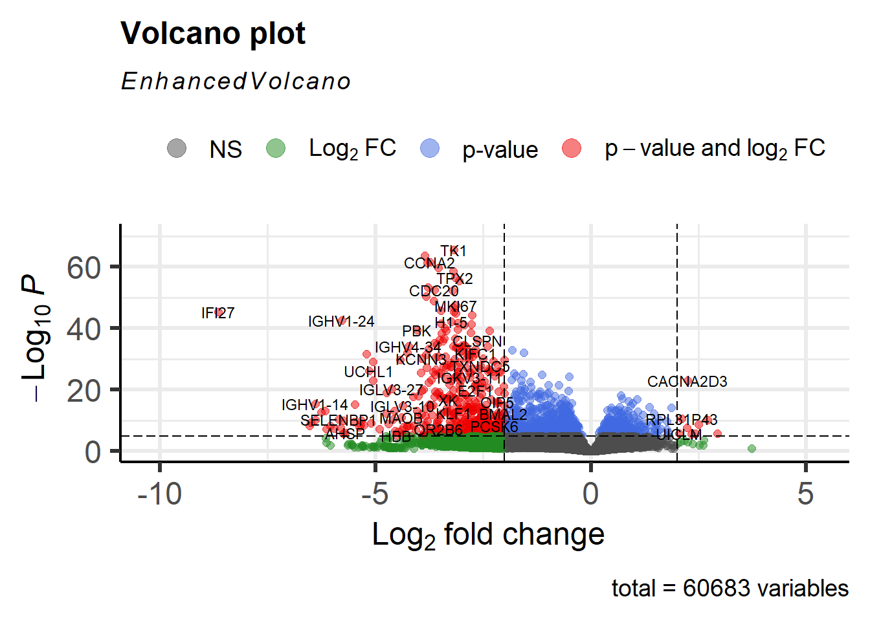
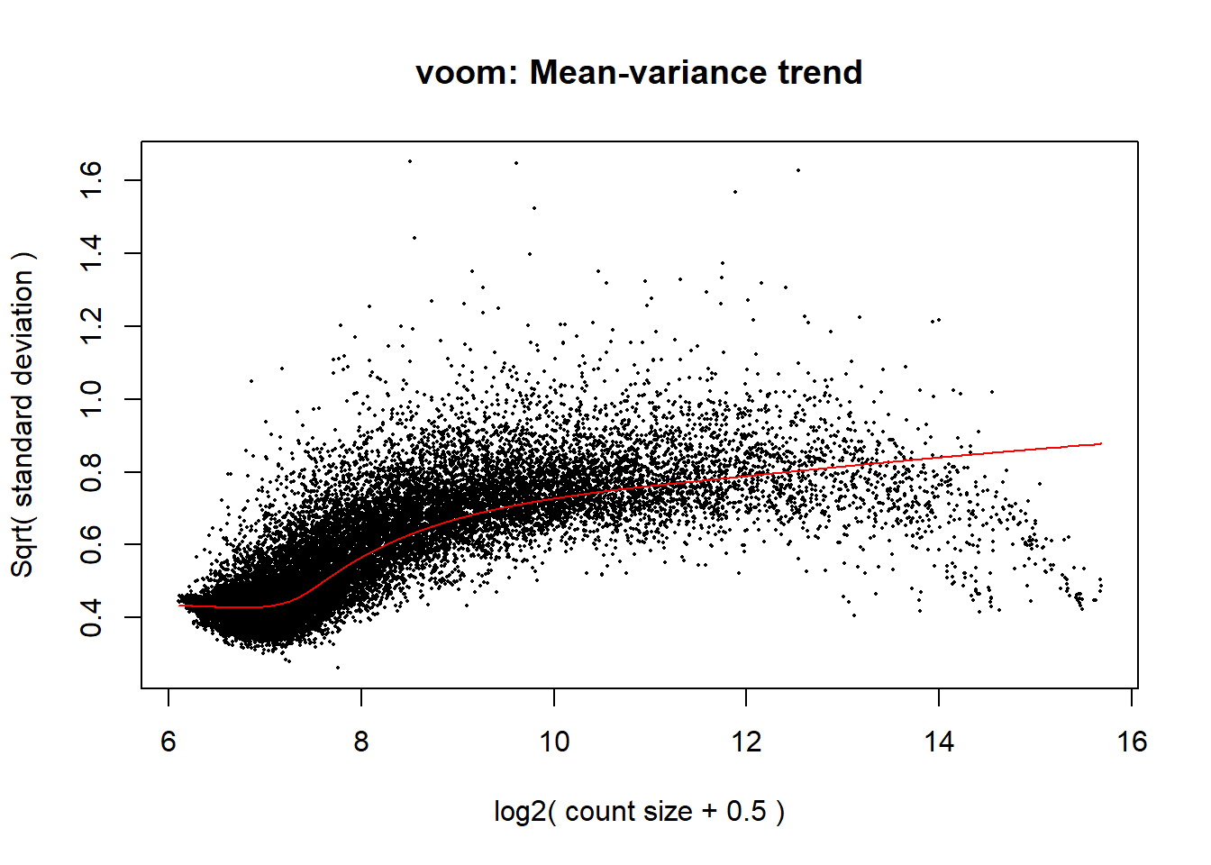
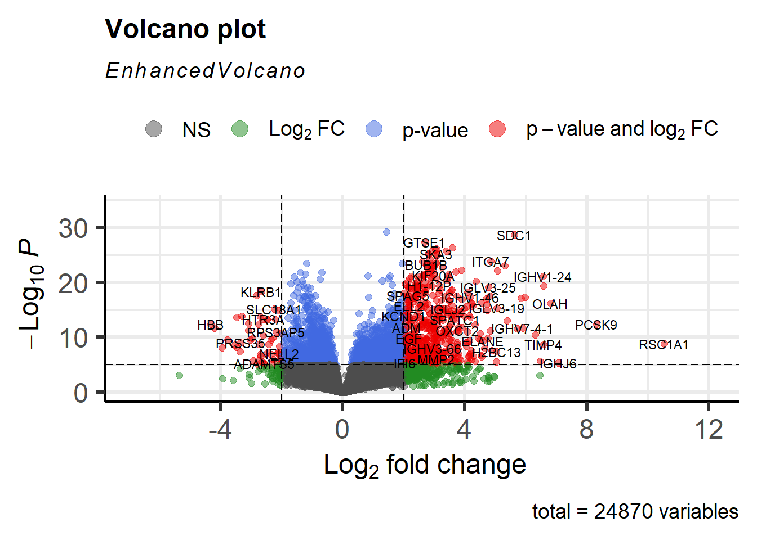
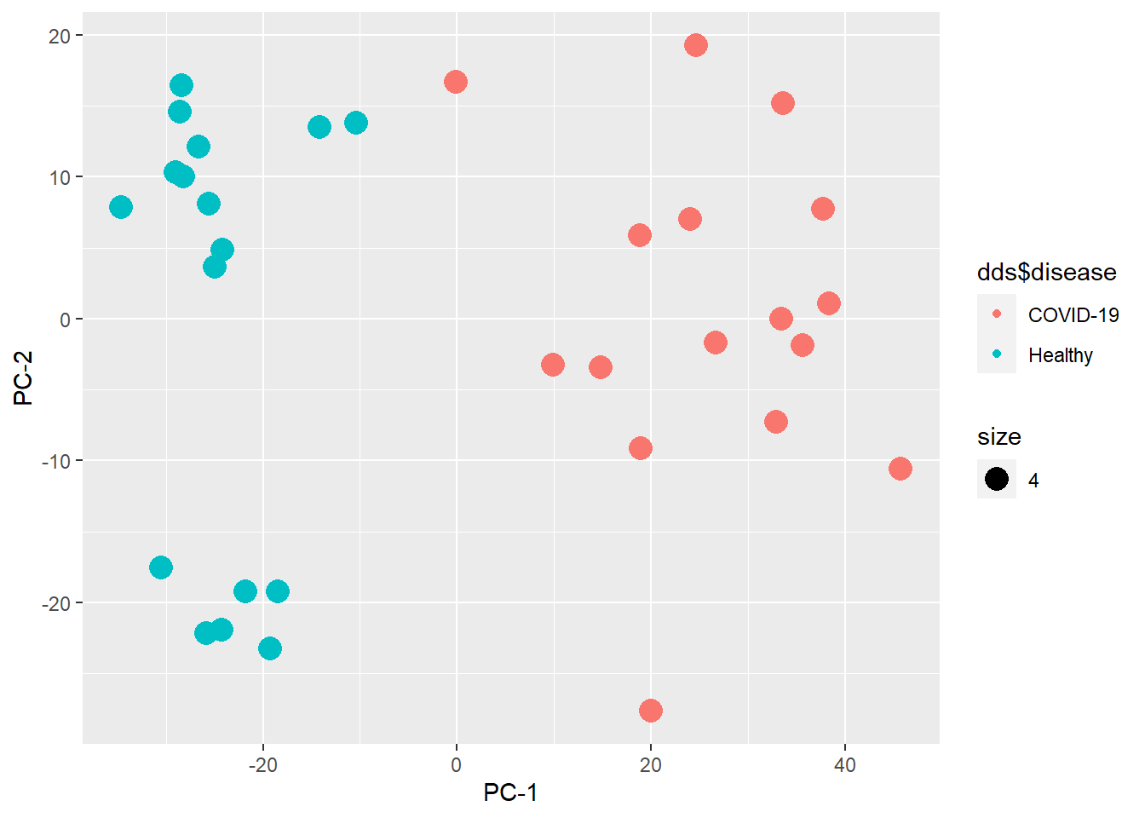
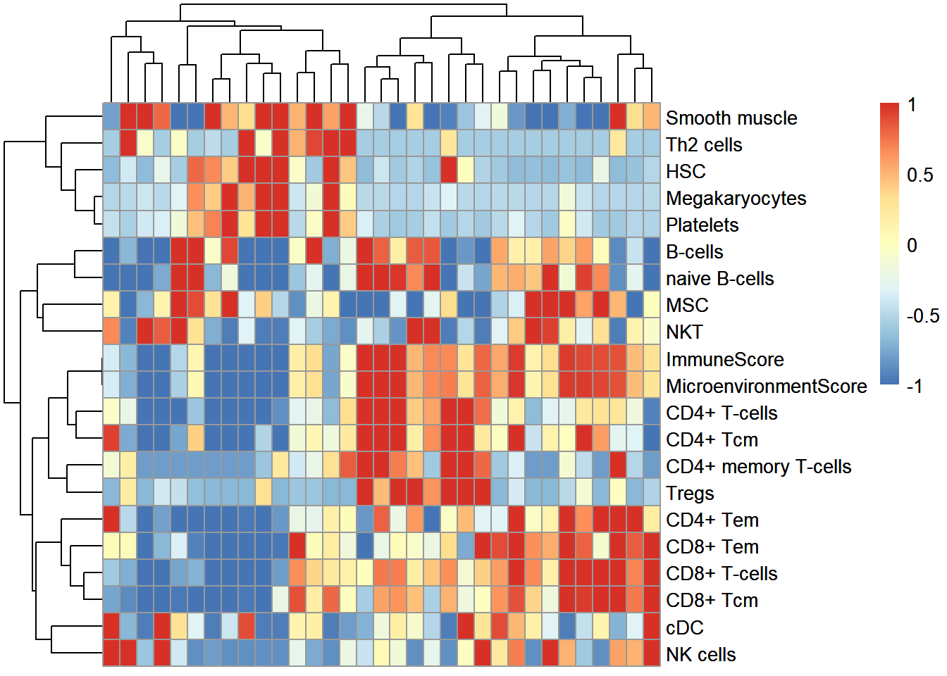
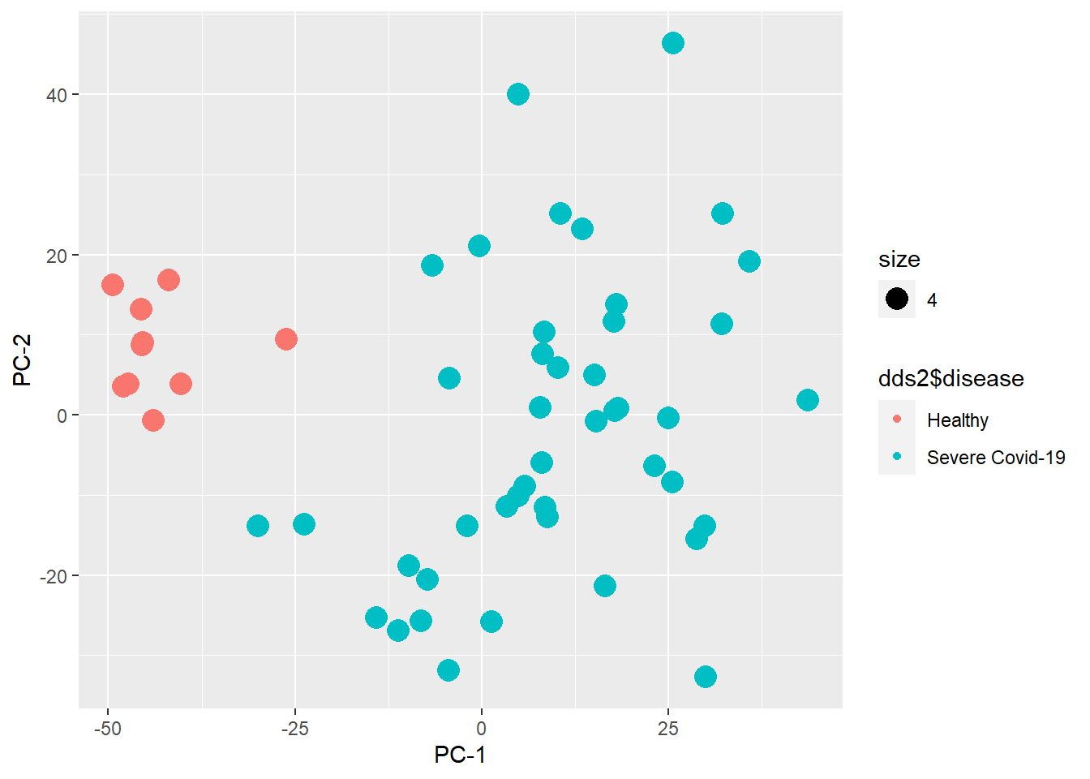
Results – additional plots

Slide 12

Conclusions and more
In our research, we managed to identify potential molecular targets, relevant biomarkers and a functional pathway (cell cycle), all related to worse prognosis of COVID-19 among patients with HIV.
Further studies can be done in the short and in the long term, using the common DEGs and related molecular compounds, to track potential drugs that might be useful for the treatment of these patients. Another research path may focus on better and faster diagnosis methods - which might be crucial to the mentioned patients, due to worse prognosis.
Hopefully, our findings will contribute to improve diagnosis and treatment for patients suffering from both diseases together.

